Slide 1


GAYATRI VIDYA PARISHAD COLLEGE OF ENGINEERING FOR WOMEN
MEMORY
BY
NAME : BANKA CHARISHMA
BRANCH : CSE
ROLL NO. : 324103210013
FACULTY : DR. K. ROHINI Ma’am

Slide 2

MEMORY
ORGANISATION OF MEMORY

Slide 3
Table of Contents
Memory
Memory Hierarchy
Pictorial representation of memory hierarchy
Registers
Cache memory
Different levels of cache memory
Primary memory
Secondary memory

Slide 4
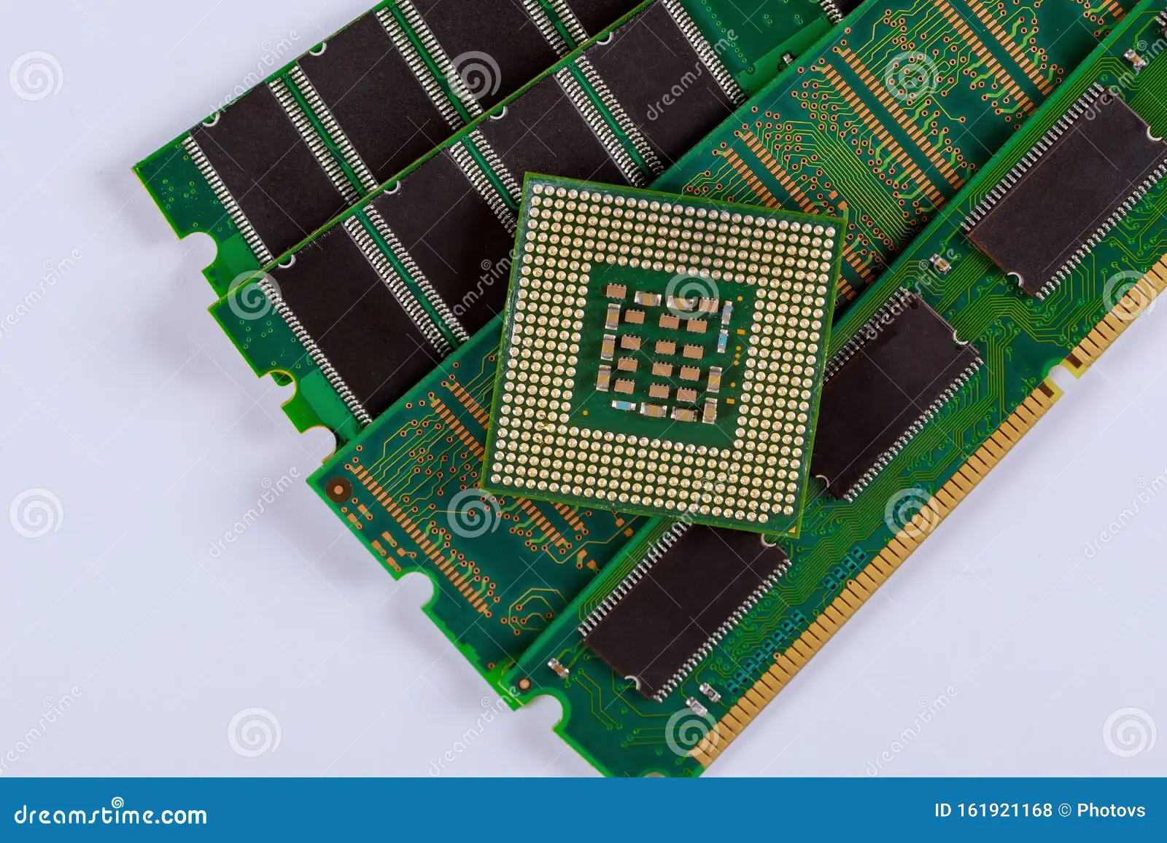
MEMORY
Computer memory is refers to physical device
that stores data or instructions temporarily or
permanently. It plays a crucial role in a
computers performance, allowing the CPU to
access data and instructions.

Slide 5
MEMORY HIERARCHY
Registers
Cache Memory
1st level Cache memory
2nd level Cache memory
3rd level Cache memory
Primary memory
Optical disk
Hard disk
Magnetic tape

Slide 6
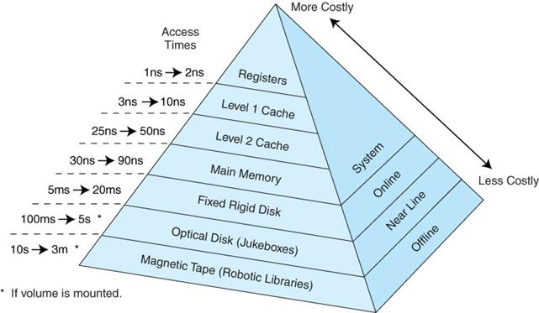

Slide 7
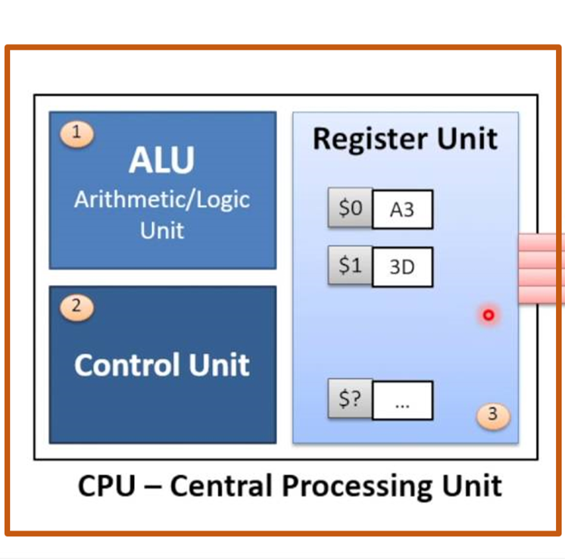
REGISTERS
Registers is the fastest and smallest unit of memory. It is embedded inside the CPU. It can only store 1 word. There are different types of registers and some of them are shown below:
PC (Program counter)
AC (Accumulator)
CIR (Current instruction resister)
MAR (Memory Address Register)
MDR (Memory Data Register)

Slide 8
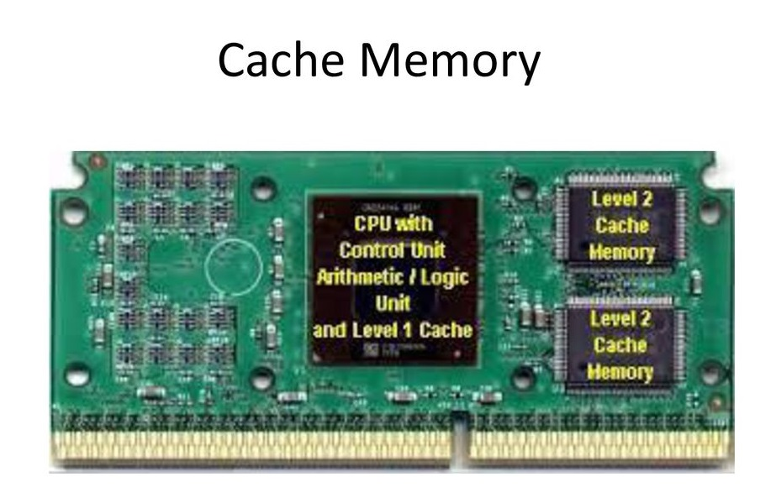
Cache Memory
Cache memory is small-sized, high speed memory that stores frequently accessed data and instructions to increase the efficiency of the CPU.
If the data or instructions for which the CPU is searching is present in the cache memory then it is known has HIT.
If not found it is known as MISS.
Hit Ratio = no. of hits/
(total no. of hits +misses)

Slide 9
Levels of Cache memory
L1 Cache: inbuilt in the architecture of microprocessors.
Also called internal cache. It is of 2 types :
L1 Data
L1 Instructions
L2 Cache: external cache memory, which are built onto the motherboard outside CPU. Composed of SRAM, large in size than L1 but slower than it.
L3 Cache: extra cache, larger than L1, L2. Slower than both of them but faster than RAM.

Slide 10
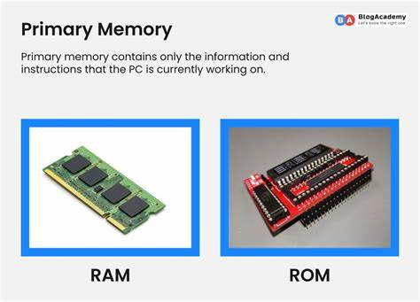
Primary Memory
Also known as Main memory.
It is the memory that is directly accessed by
the CPU.
It is mainly of 2 types :
RAM (Random access memory)
ROM (Read only memory)

Slide 11
COMPARITIVE STUDY OF RAM AND ROM
RAM
ROM
It is a temporary memory storage.
Volatile memory
The data can be modified, updated or deleted.
The instructions are written into RAM at the time of execution.
It is a permanent memory storage.
Non- Volatile memory
The instructions once written cannot be modified, does not allow write option.
The instructions are written into ROM at the time of manufacture.

Slide 12
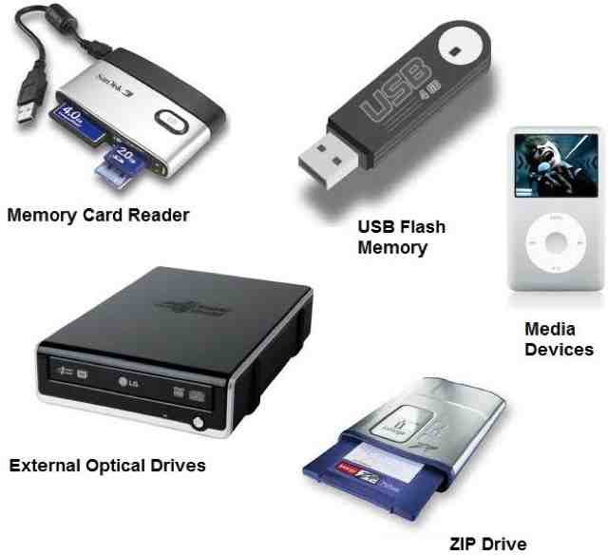
Secondary Memory
The memory that cannot be directly accessed by the CPU and can store a lot of information is known as secondary memory.
It provides a long term storage of data and instructions.
Also known as virtual memory.
Storage devices like SSD, HDD, magnetic tapes , and optical disk etc..

Slide 13


